Slide 1
“Computer”
A machine that could do calculations automatically.
Define each operation by a “machine instruction”.
Each machine instruction can do a relatively simply operation, e.g., add two numbers, or subtract one number from another number, etc.
Program is a sequence of selected instructions, created to do a required task.

Slide 2
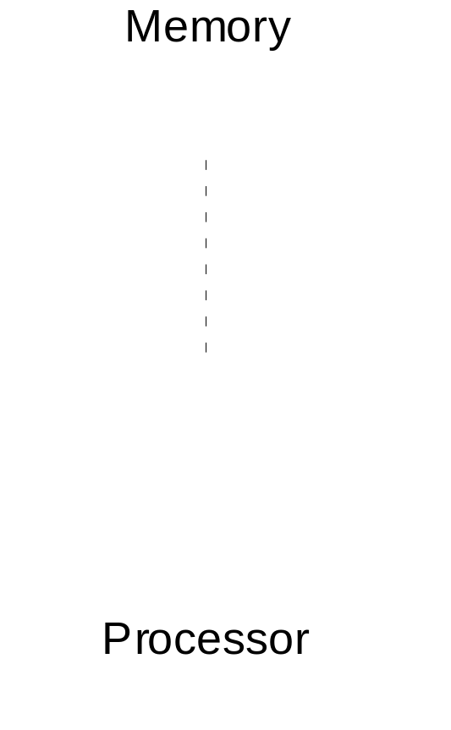
Stored Program Computer
Key idea: Being able to create different sequences to do different tasks.
Sequence of machine instructions
Reads (fetches) and executes instructions (performs actions specified).
slides1.<number>

Slide 3
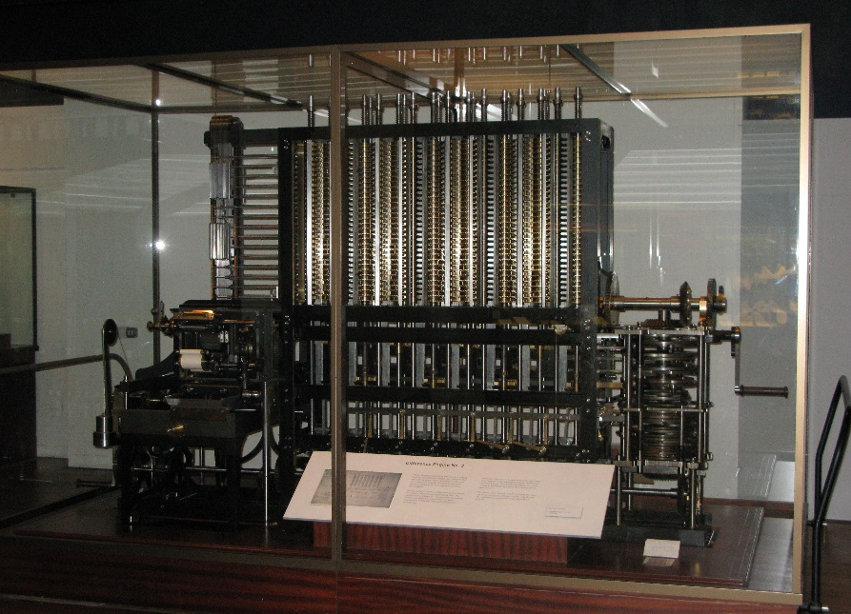
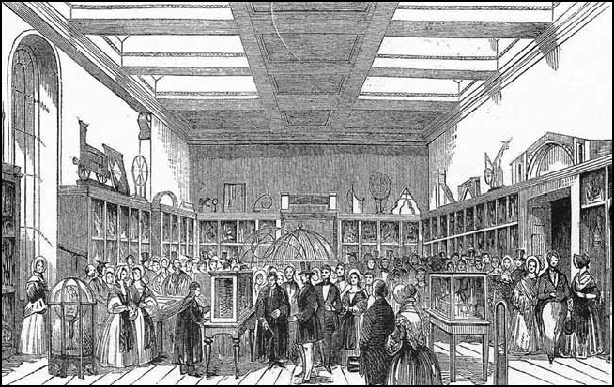
Babbage
Concept first proposed by Babbage in the 1800’s after he had developed a mechanical “difference” engine for computing functions.
His so-called analytical machine also mechanical but had the main parts of a modern computer:
Arithmetic unit and controller (processor)
Memory (punched cards)
Never completed because of mechanical complexity (gears etc).
Difference engine
Part of the Analytical Engine on display, in 1843
http://en.wikipedia.org/wiki/Charles_Babbage
slides1.<number>

Slide 4
1930 - 40’s
Special purpose digital computer.
Binary number representation rather than decimal.
Arithmetic done by logical operations.
slides1.<number>

Slide 5
Number Representation
Decimal numbers use the base ten, e.g.:
237 = 2 x 10² + 3 x 10¹ + 7 x 10⁰
Ten possible digits 0,1,2,3,4,5,6,7,8, and 9. We use decimal probably because we have ten fingers. Computers do not have fingers.
Binary numbers use the base 2, e.g.:
101 = 1 x 2² + 0 x 2¹ + 1 x 2⁰
Because only two possible digits, 0 and 1, can easily represent them in various ways. One binary digit called a “bit”.
slides1.<number>

Slide 6
Questions
How can two binary digits, 0 and 1, be represented:
1. Using voltages
Answer:
2. Using magnetism
Answer:
3. Using another way
Answer:
slides1.<number>

Slide 7
All computers (except some very early computers) use binary number representation for both representing numbers and binary patterns for encoding the machine instructions.
The memory of the computer holds binary patterns.
slides1.<number>

Slide 8
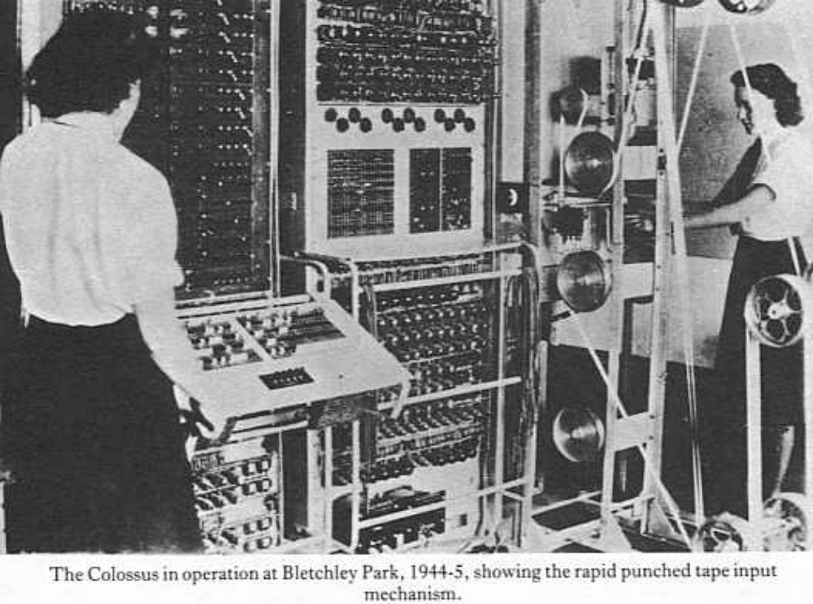
Colossus
British Government - for breaking enciphered German messages. First operational 1943. Ten built. Kept secret until 1975.
Source of picture “Alan Turing the Enigma” by A. Hodges, Simon and Schuster, 1983. Should be compulsory reading for all CS majors.
slides1.<number>

Slide 9
von Neumann computer
Describes a stored program computer that uses the memory to hold both binary encoded instructions (program) and data.
Harvard computer
A stored program computer in which separate memory is employed to hold the program and the data.
Present day computers are von Neuman although usual to have separate cache memories near processor for program and data.
slides1.<number>

Slide 10
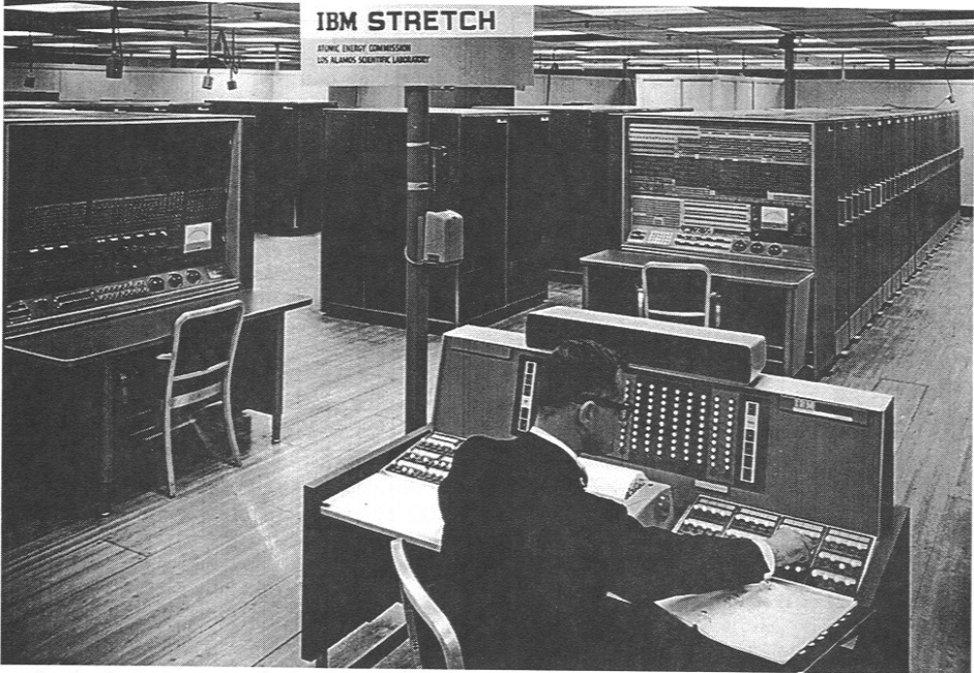
Stretch Computer
1961 IBM - Designed to “stretch” technology/performance to its limits - germanium transistor based - much faster than earlier tube based systems (IBM 704/5.) e.g. 1 microsecond add compared to 84 microsecond add.
slides1.<number>

Slide 11
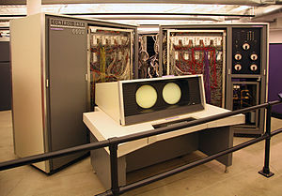
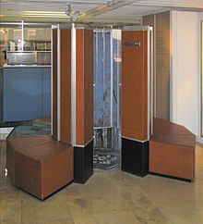
Landmarks in Computer Design since 1960
Supercomputers
Mid 1960’s - CDC 6600 - one of the first supercomputers, multiple functional units, classic 3-address instruction format (re-introduced in RISC computers in 1990’s), refrigerated. Follow-on CDC 7600.
1970’s, early 1980’s supercomputers continue to be developed. Cray 1 and Cray 2 supercomputers using the most advanced technology available to obtain the maximum speed.
http://en.wikipedia.org/wiki/CDC_6600
slides1.<number>
http://en.wikipedia.org/wiki/Cray-1

Slide 12
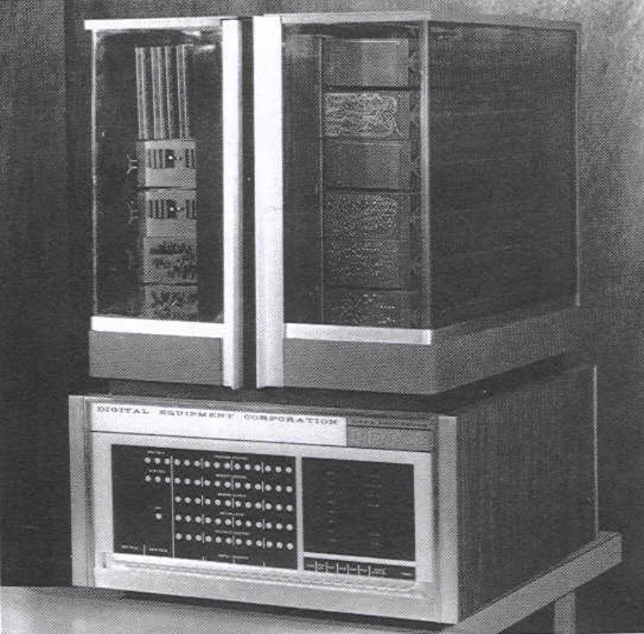
Development of families
Processors developed in “families” such that processors would be able to execute programs of earlier processors. Started with IBM 360 series in 1960’s. Concept used by all manufacturers.
“Minicomputers”
1970’s - with development of integrated circuit technology, minicomputers appeared - much lower performance but low cost and bringing computers to the laboratory - PDP 8 being the classic.
PDP 8 minicomputer
slides1.<number>

Slide 13
“Microprocessor”
Complete processor fabricated with integrated circuit technology
1970’s - First microprocessors appeared using MOS integrated circuit technology (called 4004). Intel family starts.
Early-mid 1970’s - Eight-bit microprocessors, that is, processors that can operate upon and perform arithmetic on 8-bit numbers directly, typified by the Intel 8080, Motorola MC6800 and Zilog Z-80.
Late 1970’s - Sixteen-bit microprocessors towards end of 1970s, e.g., Intel 8086 and Motorola MC68000, both introduced in 1978.
Early 1980’s - Thirty-two bit processors appeared in 1980s (e.g., Intel 386, Motorola MC68020, and MC68030. Intel 486 and Motorola MC68040 continued trend of adding facilities within chip.
slides1.<number>

Slide 14
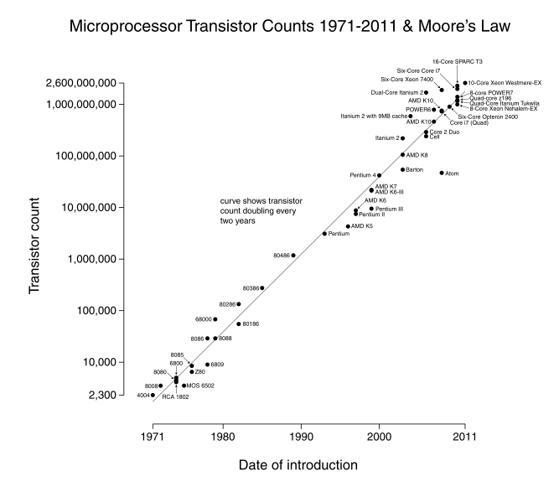
Moore’s law (1965)
Number of transistors on a chip doubles every year (or more accurately quadruples every three years, or 59%/ year).
Still applies today:
http://en.wikipedia.org/wiki/Moore%27s_law
slides1.<number>

Slide 15
Processor Design Techniques
Pipelined design - a basic technique present in earlier large computers as a way of processing instructions in a series. Introduced into microprocessors designs -- considered later in course.
Superscalar processors - more than one instruction can be executed in each cycle. Present in earlier large computers and later microprocessors. (Not covered in this course)
Additional complex instructions - Example: Extra instructions for multimedia applications (MMX technology etc.).
Sixty-four bit processors in mid 1990s. 64-bit Integer arithmetic.
Hyperthreaded computers 2000’s - Intel term. Processor designed to allow multiple threads to execute on a single processor, e.g. introduced in 2002.
Processor speeds reached 3.6 Ghz by 2004. With limited prospects for increasing it further, Intel and others went to multicore designs:
Multi-core processors mid 2000’s- fabricating multiple processors on one chip, example Intel Core-2 Duo dual-core processors
CPUs with large numbers of cores GPU designs now have 2500+ cores

Slide 16
Programming a Stored Program Computer
First computers programmed in binary machine instructions.
Then, octal (base 8) or hexadecimal (base 16) representation used. (First program I wrote was in this form!)
Assembly language invented to represent machine instructions so that did not need to know actual binary patterns.
High level language - compiler changes to machine instructions. Now more than one machine instruction often needed for each high level statement.
Binary instruction:
01101001010011110111100100011000
In hexadecimal (base 16): 694F7918
Assembly language: ADD R1, R2, R3
High level language: x = y + z;
slides1.<number>

Slide 17
Questions
slides1.<number>

